Slide 1

Parking and Camera Violation in NYC in 2020
By: Jeffrey Cheng
Notes:
Intro: So I wanted to look in parking and camera violation in NYC to find out if the rumor of city requiring a violation quota is true. However, it was instantly disapproved as violation was spread out across over all the months. With this dataset, I included 2020 violations, with all vehicles types, and has a “Guilty” or “Not Guilty” determination.

Slide 2

Goal: How Can I avoid Violations in NYC?

Slide 3

Demographics
NY Population in 2018= ~8.4 million₍₁₎
~3.1 million household₍₂₎
~1.4 million household own a car (45%)
3 % owns 3 or more cars
# of Violation in 2020 =1,054,998
# of vehicle with violation = 436,718
Max = 826
Min = 1
Avg = 2
Notes:
Census population and household percentage owning vehicle. My data comes from opendata.com and has over 1.05 million rows and 11 columns.
I used nunique function to calculate how many unique license plate there are. Then used value_count to calculate range of amount of tickets within 2020 and did an average to see what are the average violation each car would get per year.
(1) https://www.census.gov/data/developers/data-sets/acs-5year.2018.html
(2) https://edc.nyc/article/new-yorkers-and-their-cars

Slide 4

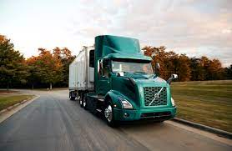



Top 5 vehicle types to get a violation
Passenger = 683,031
64.74%
Commercial = 240,661
22.81%
Taxi/Limousines = 54,378
5.15%
Motorcycle = 14,792
1.4%
City Official/Healthcare Professional/Military/Custom plates =14,240
1.35%
Notes:
There were a lot more vehicle types, so I had to sort it by descending order of vehicle type to get the top 5.

Slide 5
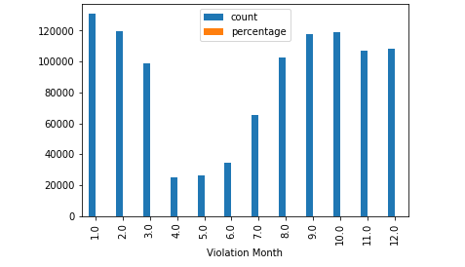
df2_allmonth =df2.reset_index().groupby(['Violation Month']).size().to_frame('count')
df2_allmonth['percentage'] = round(df2_allmonth['count'].div(1054998).mul(100),2)
print (df2_allmonth)
df2_allmonth.plot.bar()
Month | # of Violation | % of Total
January | 130,734 | 12.39%
February | 119,920 | 11.37%
March | 98,963 | 9.38%
April | 25,055 | 2.37%
May | 25,207 | 2.48%
June | 34,364 | 3.26%
July | 65,077 | 6.17%
August | 102,327 | 9.70%
September | 117,758 | 11.16%
October | 119,188 | 11.30%
November | 107,291 | 10.17%
December | 108,108 | 10.25%
Notes:
Had issue with this because I had to convert the month of issue to a datetime variable and then calculate the months. However, I had data that was not in the Jan-Dec month range, so I had to drop them.

Slide 6
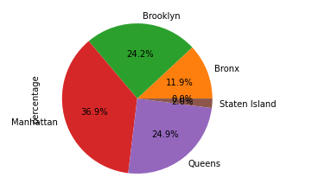
df2_allborough =df2.reset_index().groupby(['County']).size().to_frame('count')
df2_allborough['percentage'] = round(df2_allborough['count'].div(1054998).mul(100),2)
print (df2_allborough)
df2_allborough['percentage'].plot.pie(autopct="%.1f%%")
Borough | # of Violation | % of Total
Bronx | 125,453 | 12%
Brooklyn | 254,887 | 24%
Manhattan | 388,735 | 37%
Queens | 261,919 | 25%
Staten Island | 21,221 | 2%
Notes:
Use pandas to graph.

Slide 7
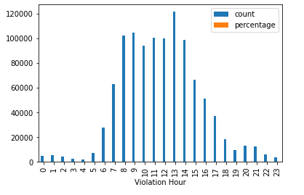
Hours of the Day | # of Violation | % of Total
1 | 4,964 | 0.47%
2 | 5,223 | 0.50%
3 | 4,253 | 0.40%
4 | 2,651 | 0.25%
5 | 1,702 | 0.16%
6 | 7,139 | 0.68%
7 | 27,822 | 2.64%
8 | 62,926 | 5.96%
9 | 102,249 | 9.69%
10 | 104,350 | 9.89%
11 | 94,239 | 8.93%
12 | 100,207 | 9.50%
13 | 99,788 | 9.46%
14 | 121,604 | 11.53%
15 | 98,649 | 9.35%
16 | 66,102 | 6.27%
17 | 51,397 | 4.87%
18 | 37,172 | 3.52%
19 | 18,497 | 1.75%
20 | 9,266 | 0.88%
21 | 12,771 | 1.21%
22 | 12,523 | 1.19%
23 | 5,675 | 0.54%
24 | 3,825 | 0.36%
Notes:
Time variable needed data cleaning, it was formatting as HH:MM, with AM/PM at the end, so I converted to datetime variable. However, data has issue as time was outside of range of 0-24.

Slide 8

Violation Determination
Top 5 Violations
Determination | # of Violation | % Total
Guilty | 651,030 | 61.71%
Not-Guilt | 403,964 | 38.29%
Fail to Display Mini Meter = 169,662
16.08%
No Parking –Street Cleaning = 98,193
9.31%
No Standing Zone = 86,695
8.22%
School Speed Zone =83,345
7.90%
No Parking –Day/Time Limits = 69,585
6.60%
Notes:
Try to see if I did get a violation, could I fight it?
What kind of violation should I avoid?

Slide 9
2 ways to import data
from google.colab import drive
drive.mount("/content/gdrive")
from google.colab import files
uploaded = files.upload()
for fn in uploaded.keys():
print('User uploaded file "{name}" with length {length} bytes'.format(
name=fn, length=len(uploaded[fn])))
Notes:
2 main thing I search for was way to import large data, with as few compromise as possible. I wanted a larger data set because it would be a more accurate picture.

Slide 10

Thank you!

